Slide 1
NIO SSH Slaves

Slide 2
What is NIO SSH Slaves
The NIO SSH Slaves plugin is an alternative SSH slave connector that uses a Non-Blocking I/O architecture. This alternative connector shows different scalability properties from the standard SSH slave connector

Slide 3
Benefits: NIO SSH Slaves
There are three main differences in scalability characteristics:
The Non-blocking I/O connector limits the number of threads that are used to maintain the SSH channel. Thus when there are a large number of channels (i.e. many SSH slaves) the Non-blocking connector will use less threads and consequently the Jenkins UI will remain more responsive than with the standard SSH slave connector.

Slide 4
Benefits: NIO SSH Slaves(Cont.)
When the Non-blocking I/O connector requires more CPU resources than are available, it responds by applying back-pressure to the channels generating the load. This allows the system to remain responsive at a consequence of increasing build times. It is important to note that under this type of load the traditional SSH slave connector typically has lost the connection with a corresponding build failure.

Slide 5
Benefits: NIO SSH Slaves(Cont.)
The Non-blocking I/O connector is optimized for reduced connection time. For example, it avoids copying the slave JAR file unless necessary; and by default it suppresses the logging of the slave environment.

Slide 6
What is NIO SSH Slaves(Cont.)
Another important technical note is that the SSH client library used in the Non-Blocking I/O connector currently only supports RSA and DSA key types and the maximum key size is determined by the JCE policy of the Jenkins Master’s JVM. Without installation of the unrestricted policy, the RSA key size will be limited to 2048 bits. Finally the Non-Blocking I/O connector currently does not support connecting to CYGWIN or other Microsoft Windows based SSH servers

Slide 7
Where do we start?
The plugin adds an additional launch method: Launch slave agents on Unix machines via SSH (Non-blocking I/O) The configuration options are almost identical to those in the traditional SSH Slaves connector.

Slide 8
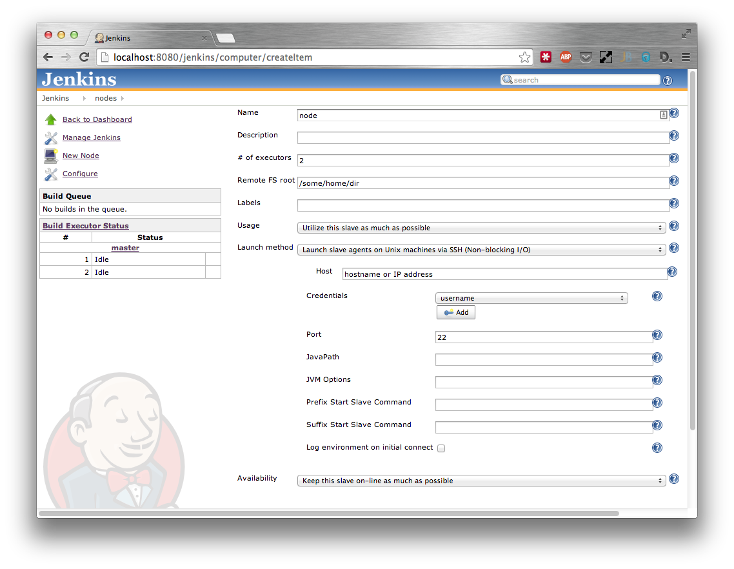
Where do we start?

Slide 9
Where do we start?
The differences between the two plugins configuration parameters are as follows:
If specified, the Prefix Start Slave Command will be appended with a space character before being prepended to the start slave command. The traditional SSH Slaves connector requires that the user remember to end the prefix with a space or a semicolon in order to avoid breaking the slave launch command.

Slide 10
Where do we start?
If specified, the Suffix Start Slave Command will be prepended with a space character before being appended to the start slave command. The traditional SSH Slaves connector requires that the user remember to start the suffix with a space or a semicolon in order to avoid breaking the slave launch command.

Slide 11
Where do we start?
The traditional SSH Slaves connector will always copy the slave environment variables to the slave launch log. The NIO SSH Slaves connector provides this as an option that defaults off. The logging of the slave environment is only of use when debugging initial connection issues and has a performance impact on the startup time. Once the slave channel has been established the slave environment variables are accessible via the Node’s System Information screen

Slide 12
Lab Exercise:
NIO SSH Slaves

